Slide 1
FINAL PROJECT TEMPLATE

Slide 2
THREAT SUMMARY
Summary of Situation: our situation here is there are a lot of people from different hospitals “Hospital A, Hospital B, and Hospital C” will be damaged, because their records “are encrypted” and they are not be able to take the best treatment they need from doctors, also systems are centralized log management systems, Windows systems that contain centralized log files and backups, control systems used to monitor patient stats are no longer available will be damaged.
Asset: our major asset are the people who needed hospitals “there information”, log management servers and patient systems, control systems used to monitor patient stats.
Impact: this attack will impact all CIA triad,
Confidentiality, patients' information may be disclosed to the public.
Integrity, this will impact information integrity because it’s with the hackers now they can to what ever they want with the data.
Availability as we can see there is no access to the information unless we pay one million dollars to the attackers.
Threat Actor: we can assume they are an organization or group who aimed to attack big systems “the name of these organization is FIN4 Bit Cryptor”, also the employee who opened the hacked email.
Threat Actor Motivation: we can assume their major motivation is the money as they wanted one million dollars, we can also assume that they wanted to hurt people who goes to hospitals, also as they called Hacktivists, they want political gains.
Common Threat Actor Techniques: they accessed the systems and run their ransomware hacker by people from technology department opening an email attachment resource, who has Windows systems that contain centralized log files and backups, unpatched Windows vulnerability.

Slide 3
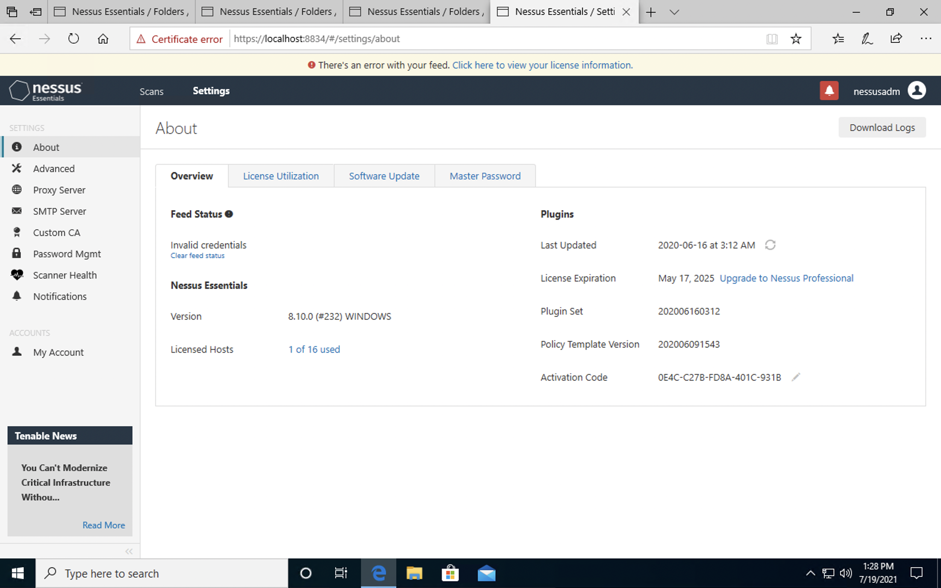
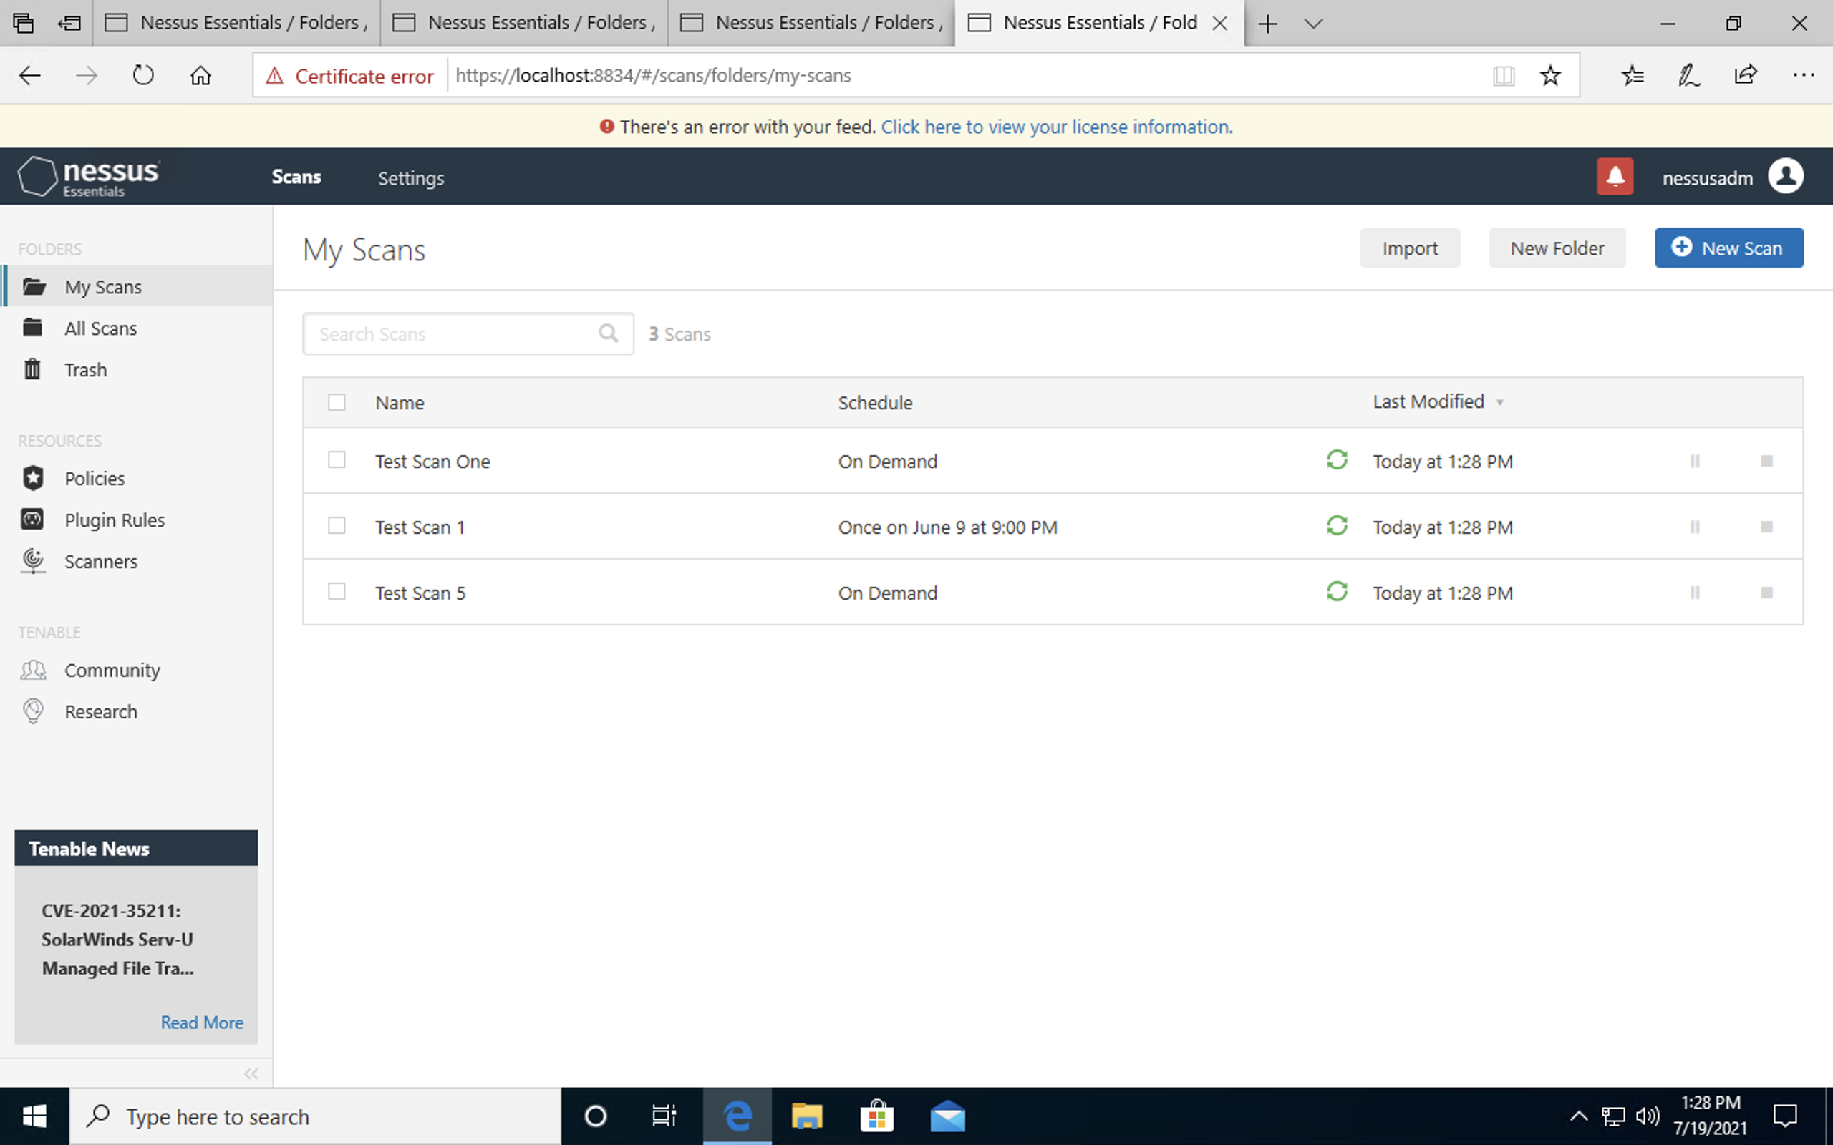
VULNERABILITY SCANNING TARGETS
Summary of scan targets:
Number of devices scanned: one device
Device type: Microsoft OS
Primary purpose of device: (describe what the devices are used for and what kind of data might be on them) the device stored the logs and information that may be useful to the attackers.

Slide 4
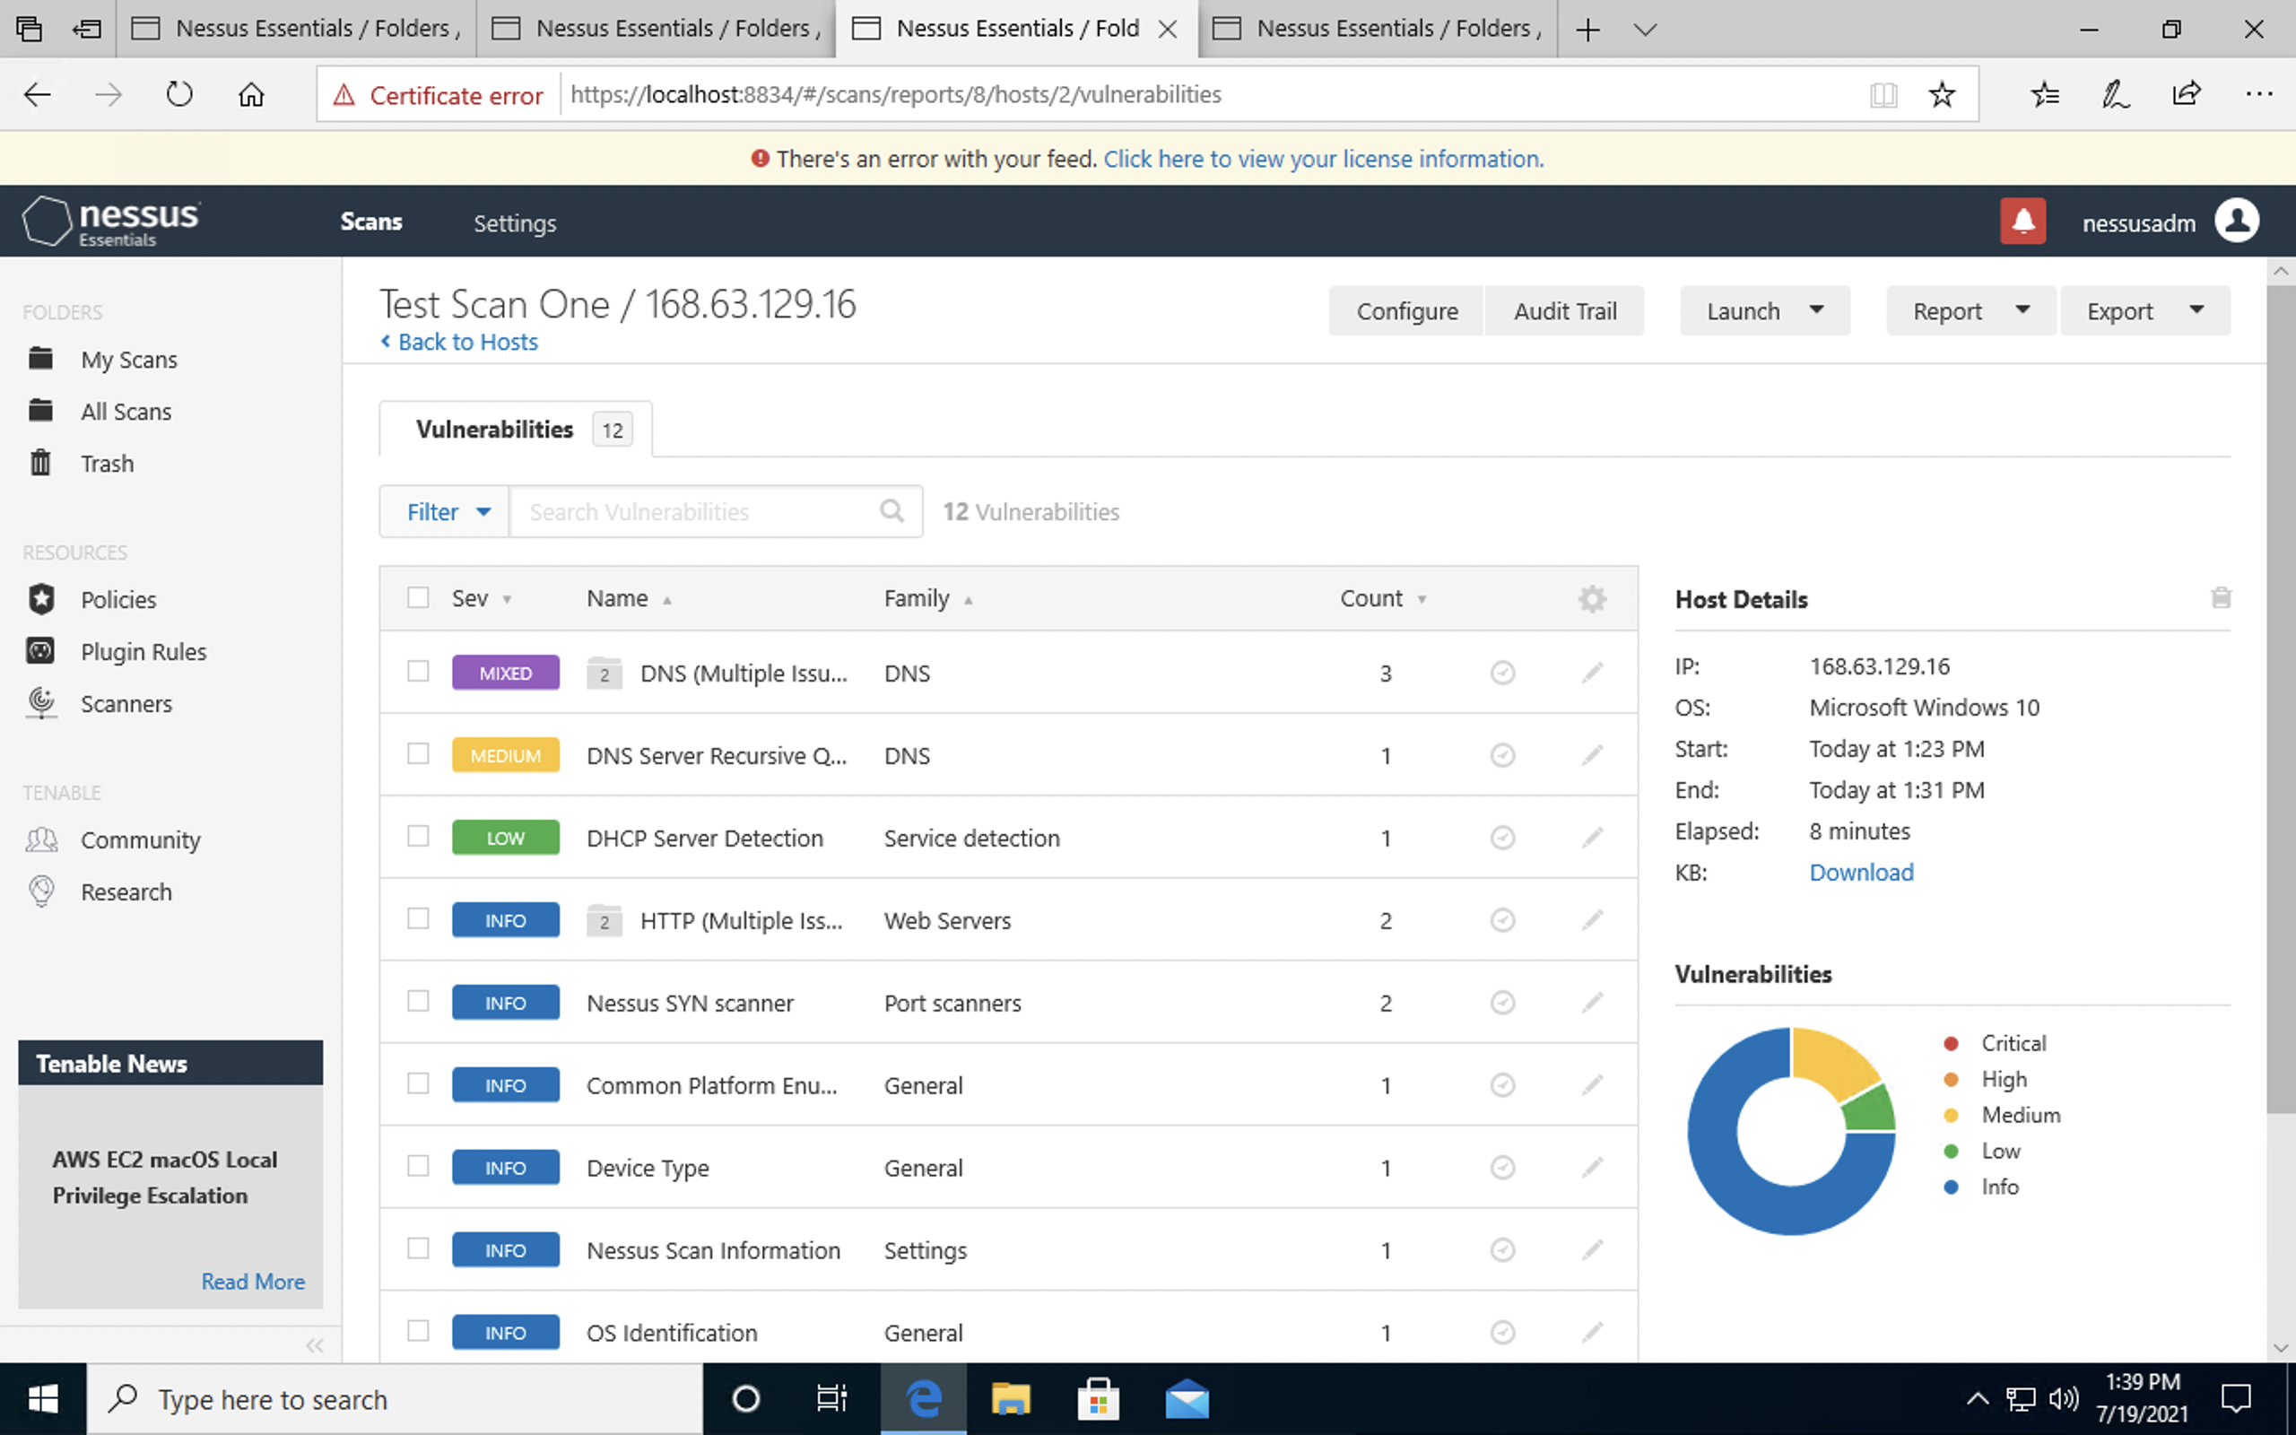
VULNERABILITY SCAN RESULTS
Summary of findings:
Total number of actionable findings:
Critical: 0
High: 0
Medium: 2
Low: 1

Slide 5
REMEDIATION RECOMMENDATION
Fix within 7 days
Finding | Severity Rating | Recommended Fix
Fix within 30 days
Finding | Severity Rating | Recommended Fix
DNS Server Spoofed Request Amplification DDoS | Medium | CVE-2006-0987
DNS Server Recursive Query Cache Poisoning Weakness | Medium | CVE-1999-0024
Fix within 60 days
Finding | Severity Rating | Recommended Fix
DHCP Server Detection | Low | Apply filtering to keep this information off the network and remove any options that are not in use.

Slide 6
PASSWORD PENETRATION TEST OUTCOME
Methodology: I used PowerShell and run hashcat64.exe
Number of passwords tested: 40
Number of passwords cracked: 38
Evidence of weak passwords:
Recommended steps to improve passwords security: the best way to make strong password is to make it unique name with capital small letters also add symbols like @#!

Slide 7
INCIDENT RESPONSE PRELIMINARY ASSESSMENT
Summarize ongoing incident:
I know that the patient's information has been stolen by the hacker and we can’t help the doctors treat their patients and will cause hurting or dyeing for some people.
Document actions or notes from the following steps of the initial incident response checklist
Step 1: here we document name and number of the people who discovered the incident
Step 2: we write the Impact Considerations
Step 3: we documented the incident severity and if its critical or not
Step 4: we investigate if human life is at risk or not, also the systems
Step 6: here we choose the incident risk category ticket

Slide 8
INCIDENT RESPONSE RECOMMENDED ACTION
Summarize recommendation to contain, eradicate, and recover:
We must update our systems to avoid hackers like those, also train our employee with this kind of attack and social engineering hacks, also from our monthly backups we can recover a great amount of data from our lose.
Documented actions and notes from the IR checklist
Step 7: we must choose Malware response procedure , Insider threat procedure
Step 8: here the IR team use digital forensic techniques
Step 9: recommendations should the IR team make to prevent occurrence from happening again or infecting other systems
Step 12: we investigates the recommended updates

